Slide 1

Chapter One
Introduction to Management and Organizational Behaviour
Copyright © Houghton Mifflin Company. All rights reserved.
1 - <number>

Slide 2
Contents to be covered
Business
Organization
Management
Development of Management
Principles of Management
Management Process
Levels of Management
Roles and Skills of Manager
Organizational Behaviour (OB)
Major Disciplines/Areas of OB
Basic Model of OB
Copyright © Houghton Mifflin Company. All rights reserved.
1 - <number>

Slide 3

Business is nothing it’s all about 6 M !!!!!
B=∑ P+E
P= Factors of production (Men, Machines, Materials, Money, and Methods)= 5Ms
E= Exchange of goods and services=Market=1 M
General perceptions
It must be related with economic activity
It must be involved in legal activity
It must be connected to some factors of productions.
Products or services usually should exchange in a market place
The main motive must be earning profit.
Copyright © Houghton Mifflin Company. All rights reserved.
1 - <number>

Slide 4
Business
Business is the activity of producing, buying, or selling goods and services to generate profit. It involves individuals or organizations engaging in commerce, industry, or trade. Businesses can be small (local shops) or large (multinational corporations) and operate in various sectors like retail, manufacturing, finance, and technology. Successful businesses identify customer needs, manage resources efficiently, and adapt to market changes.
Example: Apple Inc. is a global technology company that designs and sells electronics like iPhones and MacBooks. It generates revenue by offering high-quality products and services, demonstrating innovation and strong brand loyalty in the competitive tech industry.
Copyright © Houghton Mifflin Company. All rights reserved.
1 - <number>

Slide 5
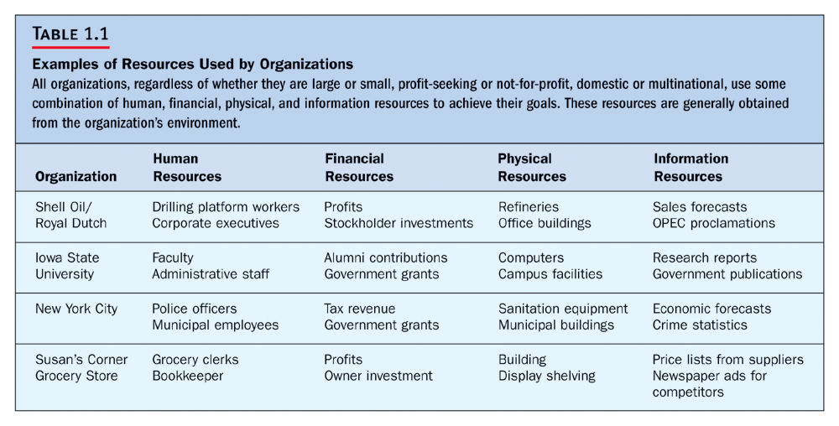
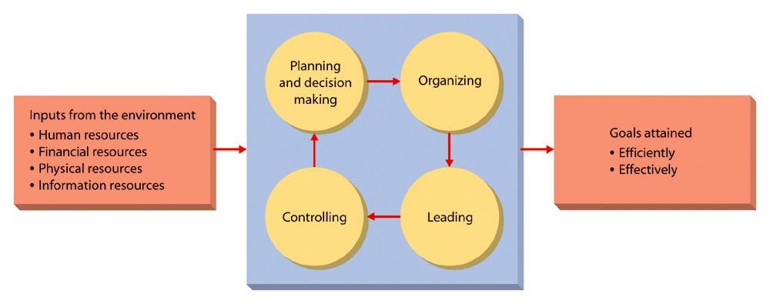
What Is an Organization?
A group of people working together in a structured and coordinated fashion to achieve a set of goals.
How Do Managers Combine and Coordinate the Various Kinds of Resources?
1 - <number>

Slide 6

What Is Management?
Management= Manage + Men+ T(Tactfully)
A set of activities (including planning and decision making, organizing, leading, and controlling) directed at an organization’s resources (human, financial, physical, and informational) with the aim of achieving organizational goals in an efficient and effective manner
1 - <number>

Slide 7

The Management Process
Planning
Setting the organization’s goals and deciding how best to achieve them.
Organizing
Determining how best to group activities and resources.
Leading
Motivating members of the organization
Controlling
Monitoring and correcting activities
1 - <number>

Slide 8
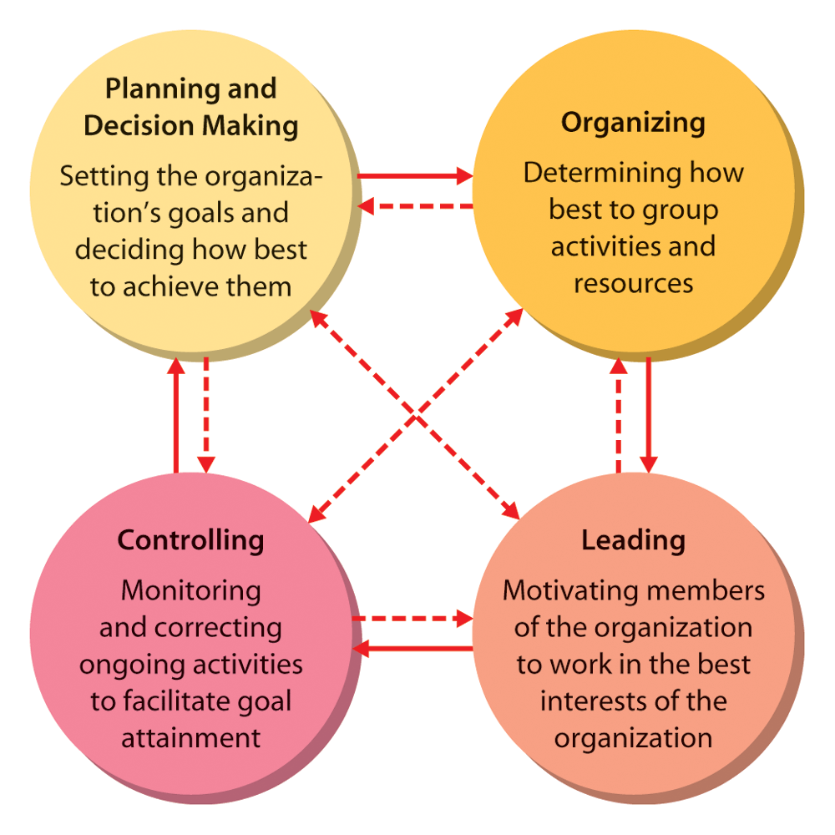
The Managerial Process
1 - <number>

Slide 9


Kinds of Managers
Managing at Different Levels of the organization:
  Top Managers
    Small group of executives who manage the overall organization, the strategic level.
Middle Managers
    A large group that implement the strategies developed at the top.
First-Line Managers
  Supervise and coordinate the activities of operating employees.
1 - <number>

Slide 10
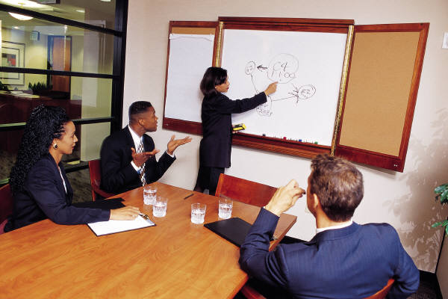
Basic Managerial Roles and Skills
Regardless of level or area within an organization, all managers must play certain roles and exhibit certain skills in order to be successful, such as:
  Do certain things
  Meet certain needs
  Have certain responsibilities
1 - <number>

Slide 11
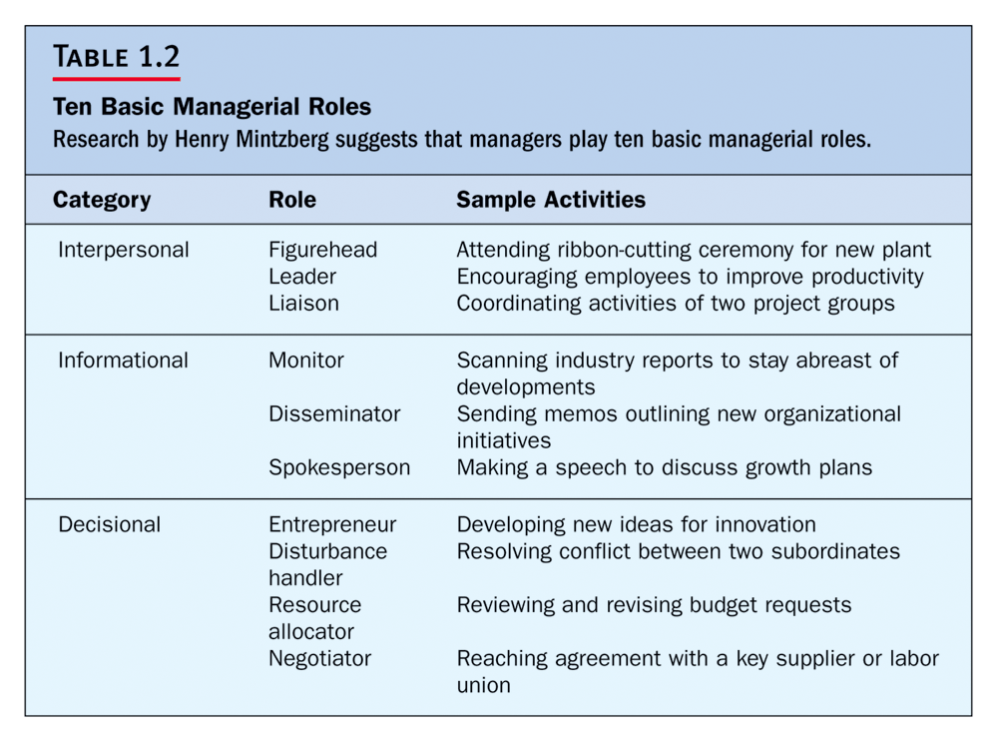
The ten roles as per Mintzberg (1973)
1 - <number>

Slide 12
Let’s Discuss – 10 minutes
What kind of managerial role do you play in your organization or would like to do in the future?
Copyright © Houghton Mifflin Company. All rights reserved.
1 - <number>

Slide 13


Managerial Skills
In addition to fulfilling roles, managers also need a number of specific skills.
The most fundamental management skills are:
  Technical
  Interpersonal
  Conceptual
  Technical Skills
Necessary to accomplish or understand the specific kind of work being done.
These skills are especially important for first line managers.
1 - <number>

Slide 14


Interpersonal Skills
The ability to communicate with, understand, and motivate both individuals and groups.
Be able to get along with:
  Subordinates
  Peers
  Those at higher levels
Conceptual Skills
A manager’s ability to think in the abstract.
The mental capacity to:
  Understand organizational goals and its environment.
  How the organization is structured.
  Viewing the organization as system.
1 - <number>

Slide 15
Organizational Behaviour (OB)
Organization
A purposeful coordinated social unit composed of two or more people that functions on a relatively continuous basis to achieve a common goal or set of goals.
Behaviour
Behaviour is an action that is observable and measurable. Usually, behavior is observable.
For example, a student may show anger by making a face, yelling, crossing his arms, and turning away from the classroom
What indicates?
Organizational Behaviour (OB)
OB is a field of study that investigates the individuals’, groups’ behavior within organizations for the purpose of applying such knowledge toward improving an organization‘s effectiveness.

Slide 16
Outcome Variables (Individual)
Organizational citizenship behavior
  The discretionary (optional) behavior that is not part of an employee’s formal job requirements, and that contributes to the psychological and social environment of the workplace, is called organizational citizenship behavior.
Withdrawal behavior
  Withdrawal behavior is the set of actions that employees take to separate themselves from the organization.
Copyright © Houghton Mifflin Company. All rights reserved.
1 - <number>

Slide 17
Pair task (2 students)
Assume a new product to launch in the market
What could be the managerial process?
Explain the 4 steps with examples
Use your own experience and expertise
Present your idea – 5 minutes for each pair.
Copyright © Houghton Mifflin Company. All rights reserved.
1 - <number>

